Slide 1
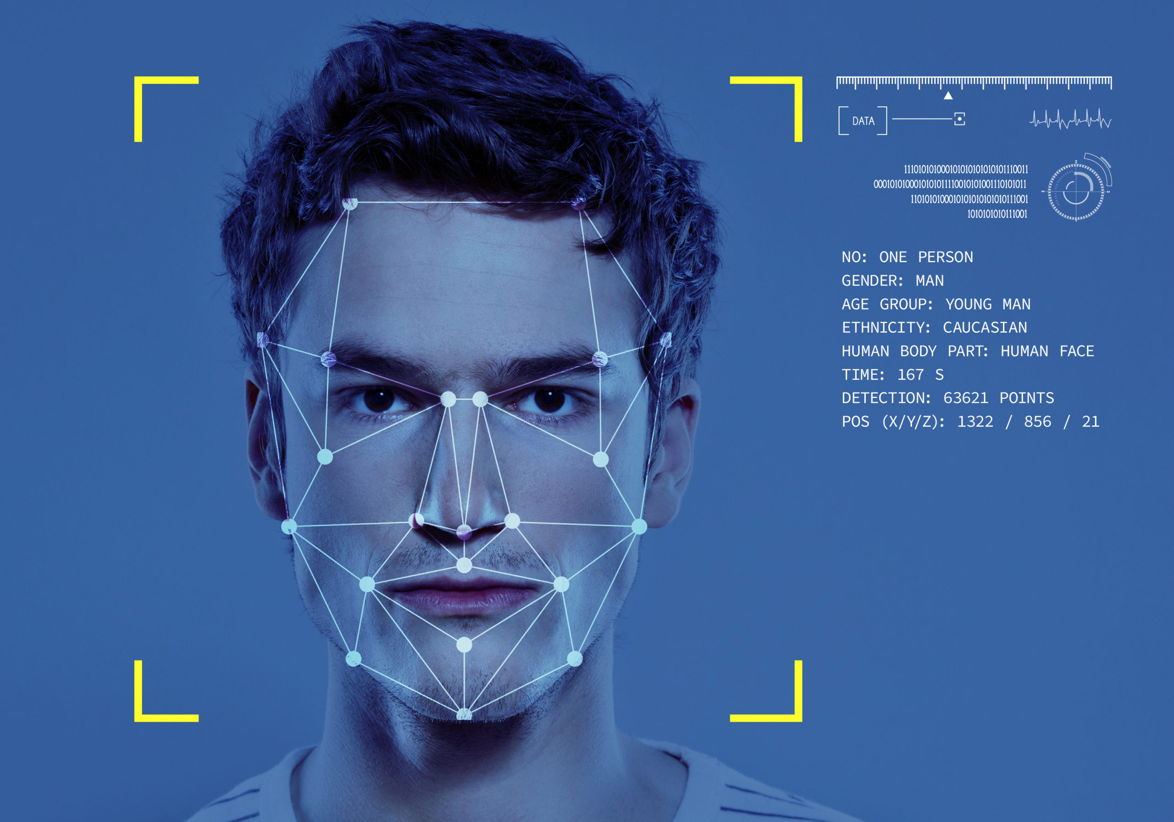
Face Recognition Attendance System
By Simarjit Singh BCA 3rd Year

Slide 2
Contents
Introduction
Hardware and Software Requirements
What Exactly is Biometrics?
Types of Biometrics
Why do we choose face recognition over other biometrics?
Technologies used
Implementation of Face recognition technology
How does the Face recognition system works?
Face Graph
Demo
References
Scope
Conclusion

Slide 3
Introduction
Face recognition is a biometric technique that involves the use of computer algorithms to identify or verify the identity of individuals based on their facial features.
This technology has a wide range of applications, including security systems, access control, and identification systems.
In recent years, the advancement of computer vision and deep learning algorithms has led to the development of high-accuracy face recognition systems.
Notes:
1. Biometrics is a measurement and analysis of basic human characteristics like face, fingers, eye(retina), etc.

Slide 4
REQUIREMENTS
Hardware:-
At least 4GB of ram
SSD
Webcam
Intel i3 or higher
Software:-
Windows 10 or higher
Python 3.11 or higher
OpenCV and NumPy
Notes:
Intel i3 10th generation or higher must be used

Slide 5
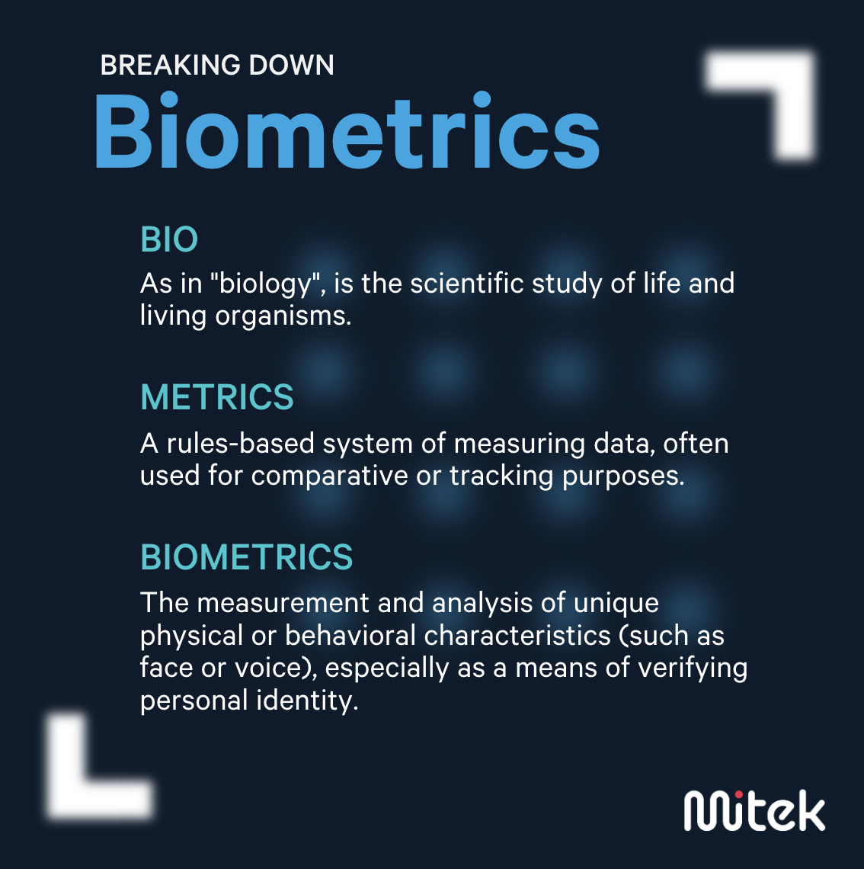
Notes:
In this slide we will be Breaking down ‘what is biometrics?’

Slide 6
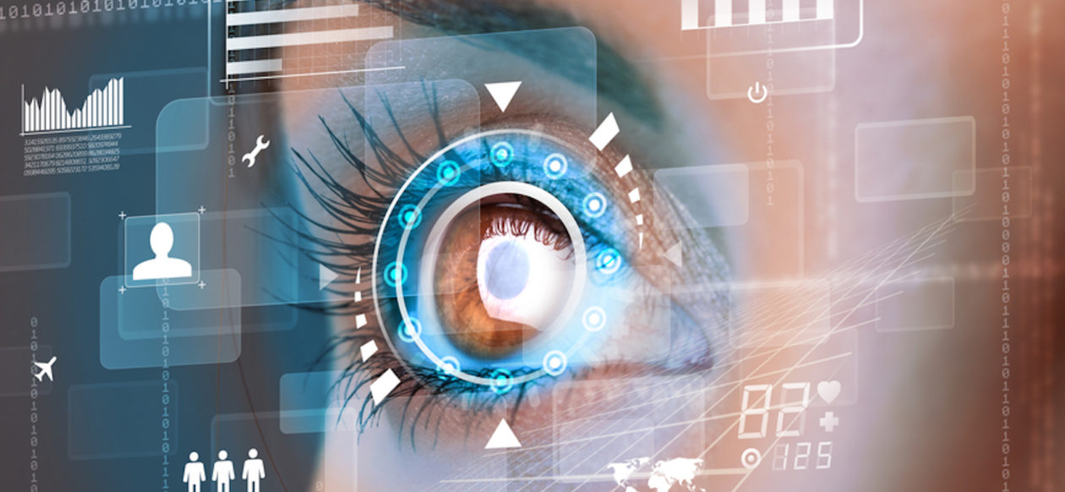
Types of Biometrics
Notes:
These are the types of biometrics which are generally used in day-to-day activities.

Slide 7
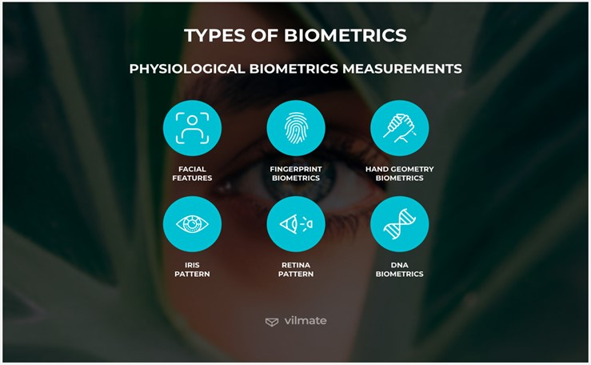
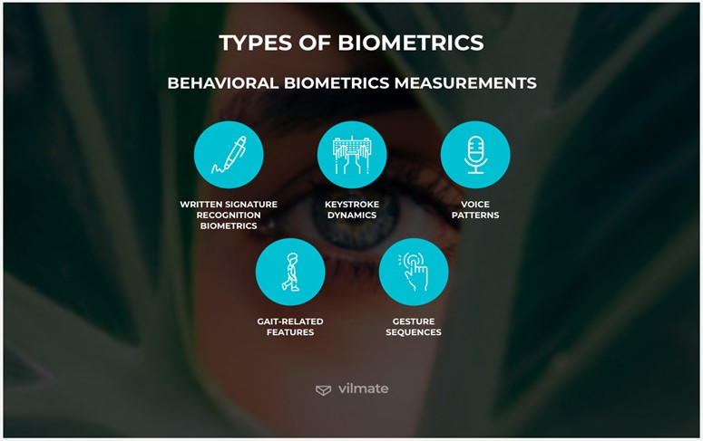
1. Physical Identifiers
This type of biometric performs a physical scan of a person (Iris, retina, fingerprint, face, voice, DNA, and signature scans are included in the biometric physical identifiers).
The type of biometric that performs a physical scan is generally more often heard and you can find it in everyday life.
Examples include smartphones and Aadhar Verification, etc.
2. Behavioural Identifiers
Behavioral identifiers are a type of biometric that scans human behaviour.
The question “Is it possible to scan human behaviour?”. Of course, it’s possible! In fact, this scan is already used by companies.
In particular, this type of biometric is used to distinguish humans and robots when using the internet.
Types of Biometrics

Slide 8
1. Physical Identifiers
This type of biometric performs a physical scan of a person (Iris, retina, fingerprint, face, voice, DNA, and signature scans are included in the type of biometric physica identifiers).
The type of biometric that performs a physical scan is generally more often heard and you can find it in everyday life.
Examples include smartphones and Aadhar Verification, etc.
2. Behavioural Identifiers
Behavioral identifiers are a type of biometric that scans human behaviour.
The question “Is it possible to scan human behaviour?”. Of course, it’s possible! In fact, this scan is already used by companies.
In particular, this type of biometric is used to distinguish humans and robots when using the internet.
Types of Biometrics

Slide 9
Physical Identifiers
This type of biometric performs a physical scan of a person (Iris, retina, fingerprint, face, voice, DNA, and signature scans are included in the type of biometric physical identifiers).
The type of biometric that performs a physical scan is generally more often heard and you can find it in everyday life.
Examples include smartphones and Aadhar Verification, etc.
2. Behavioural Identifiers
Behavioral identifiers are a type of biometric that scans human behaviour.
The question “Is it possible to scan human behaviour?”. Of course, it’s possible! In fact, this scan is already used by companies.
In particular, this type of biometric is used to distinguish humans and robots when using the internet.
Types of Biometrics

Slide 10
Physical Identifiers
This type of biometric performs a physical scan of a person (Iris, retina, fingerprint, face, voice, DNA, and signature scans are included in the type of biometric physical identifiers).
The type of biometric that performs a physical scan is generally more often heard and you can find it in everyday life.
Examples include smartphones and Aadhar Verification, etc.
2. Behavioural Identifiers
Behavioral identifiers are a type of biometric that scans human behaviour.
The question “Is it possible to scan human behaviour?”. Of course, it’s possible! In fact, this scan is already used by companies.
In particular, this type of biometric is used to distinguish humans and robots when using the internet.
Types of Biometrics

Slide 11
Why do we choose face recognition over other biometric?
There is a number of reasons to choose face recognition. This includes the following :
It requires no physical interaction on behalf of the user.
It can use your existing hardware infrastructure.
It is the only biometric that allows you to identify any person in real-time (e.g.: Identifying a person/ suspect in a crowded place)

Slide 12



Technology used
Haarcascade Algorithms Python Tkinter

Slide 13
Implementation of Face Recognition technology
The implementation of face recognition technology includes the following three stages:
Data (Face Image) acquisition
Data processing
Data Classification and decision making

Slide 14
HOW DO FACE RECOGNITION SYSTEMS WORK?
If you look in the mirror, you can see that your face has certain distinguishable landmarks. These are the peaks and valleys that make up the different facial features. Software defines these landmarks as nodal points.
There are about “80 nodal points” on a human face.
Here are a few nodal points that are measured by the software.
distance between the eyes
Width of the nose
Depth of the eye socket
cheekbones
Jaw line
chin

Slide 15
Flowchart

Slide 16
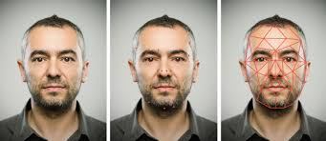
Face BuNch Graph
A Face bunch graph is created from “70 nodal points” to obtain a general representation of a face.
Given an image the face is matched to the Face buch graph to find the same point.
These nodal points are measured to create a numerical code, a string of numbers that represents a face in the database. This code is called face print.
Only 14 to 22 nodal points are needed for face it software to complete the recognition process.

Slide 17
Flow chart

Slide 18
ER Diagram

Slide 19
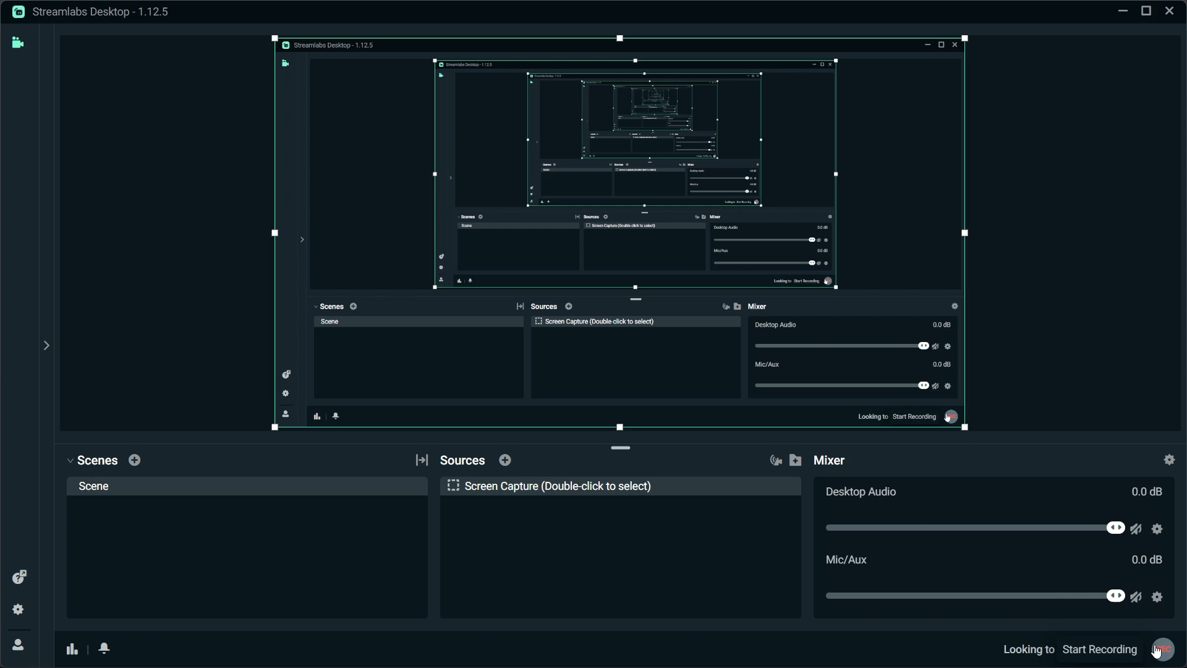
Demo

Slide 20
References
Slideshare.net
www.Bing.com
www.google.com
www.ad-ins.com
www.vilmate.com
www.GeekforGeeks.com

Slide 21
Scope of Project
A face recognition attendance system that identifies and records the attendance of individuals on their faces.
It is convenient and precise
However, it also faces challenges such as accuracy, privacy, and ethics.

Slide 22
Conclusion
In the context of a face recognition project using Python and OpenCV, the conclusion would summarize the results achieved, the challenges faced and the future scope for improvement.
Face recognition technologies have been associated generally with very costly top secure applications.
Today, the core technologies have evolved and the cost of equipment is going down dramatically due to the integration and the increasing processing power.
Certain applications of face recognition technology are now cost-effective, reliable and highly accurate.
As a result there are no technological or financial barriers to stepping from the pilot project to widespread deployment.

Slide 23
Submitted in partial fulfilment of the requirement For the Award of the Degree of Bachelor of Computer application
Under the Supervision of:- SUBMITTED BY:- Mrs. RUPALI KHARCHE SIMARJIT SINGH
Submitted to
SWAMI SHRI SWAROOPANAND SARASWATI MAHAVIDYALAYA HUDCO, BHILAI
Hemchand Yadav Vishwavidyalaya, Durg (C.G.)

